Slide 1
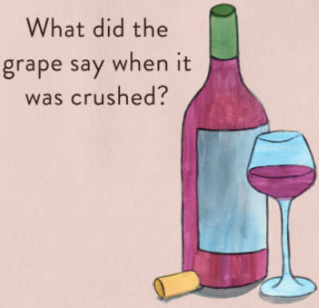
From Data Scientist to Sommelier
Brandie Parker, Jong Kim,
Junki Ogawa, Charlotte Coolidge
Notes:
Charlotte- Chardon-hey!
Nothing, it just let out a little wine

Slide 2
Table of contents
Background
Goal/Scope
What factors can determine quality?
Process
Data Process Steps
Machine Learning Models used
Random Forest Classifier
Data Architecture
Site/Tool Demonstration - Walkthrough
Findings and Opportunities
Resources
Questions?

Slide 3
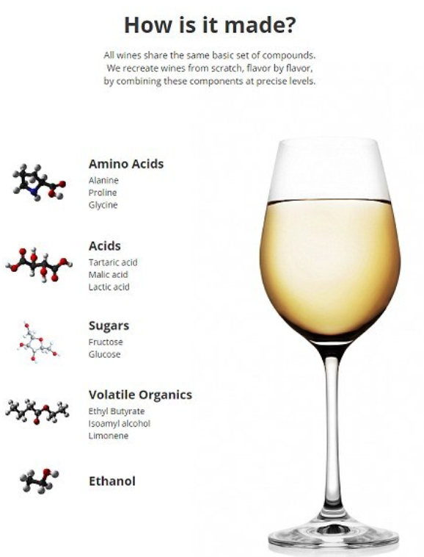
Background
Why we chose this idea? (brandie’s experience)
Madison - wine connoisseur
Notes:
Charlotte
Our first iteration idea was to do a ML Wordle project, but we quickly found that our idea was going to
“Show of hands - call on group w/ a question about wine”

Slide 4

Goal/Scope
Find model that provides the best score and most accurately categorizes the wines based on their chemical data into a wine rating
Use the model to predict how a wine will rate based on its chemical properties (alcohol content, residual sugar, acidity, etc)
Notes:
Charlotte - Transition to Brandie

Slide 5
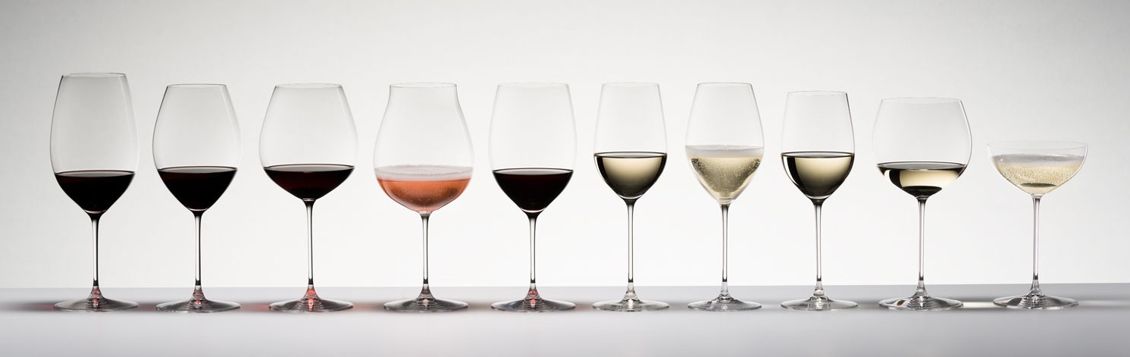
What factors can determine quality?
Acids
add to the taste, scent, and freshness of wine
Chlorides
too much can result in salty or flat wine
Alcohol
ideal alcohol content is 13.5%+
Sulfur Dioxide
helps to stabilize wine to stand the “test of time”
Notes:
Brandie

Slide 6
Process
Research: Kaggle dataset
Preprocess the dataset
get_dummies
standardScaler
ML we’re using
Supervised:
Logistical
Regression
Random Forest Classifier
Plot the model scores to see how they compare
Notes:
Brandie
Mention that we tried unsup and deep learning models as well

Slide 7
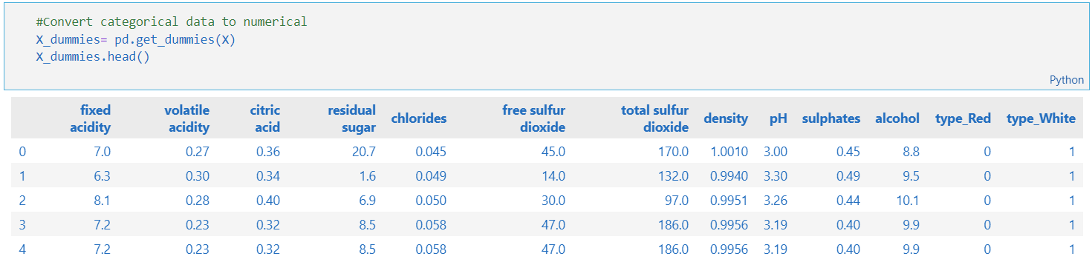
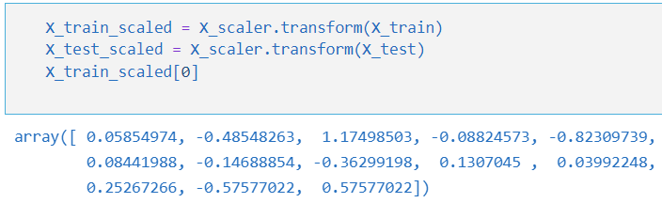
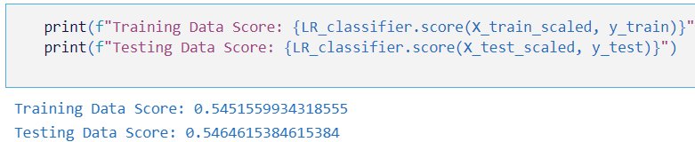
Data Process Steps
Data Processing:
Data Scaling:
Logistic Regression:
Notes:
junki

Slide 8
Machine Learning Models used
Model: Logistic Regression
Training Data Score: 0.538998
Testing Data Score: 0.542769
Model: Random Forest Classifier
Training Score: 1.0
Testing Score: 0.692923
Model: Lasso
Train score: 0.0
Test Score: -0.000654
Model: LinearRegression
Train score: 0.002049
Test Score: -0.002469
Model: KNeighborsRegressor
Train score: 0.189193
Test Score: -0.217372
Model: RandomForestRegressor
Train score: 0.735172
Test Score: -0.155091
Model: ExtraTreesRegressor
Train score: 0.846294
Test Score: -0.306193
Model: AdaBoostRegressor
Train score: 0.012325
Test Score: -0.003602
Model: SVR
Train score: 0.061404
Test Score: -0.013790
Unsupervised
TSNE / K-MEANS Clustering
Deep Learning
keras/Tensorflow
Notes:
junki

Slide 9
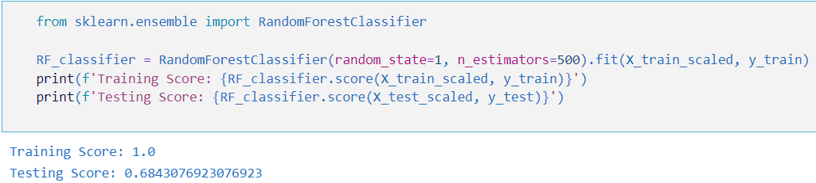
Random Forest Classifier
Why Random Forest Classifier
Features have at least some predictive power, and reducing features will improve scores
The trees of the forest and more importantly their predictions need to be uncorrelated (or at least have low correlations with each other).
Notes:
Junki

Slide 10
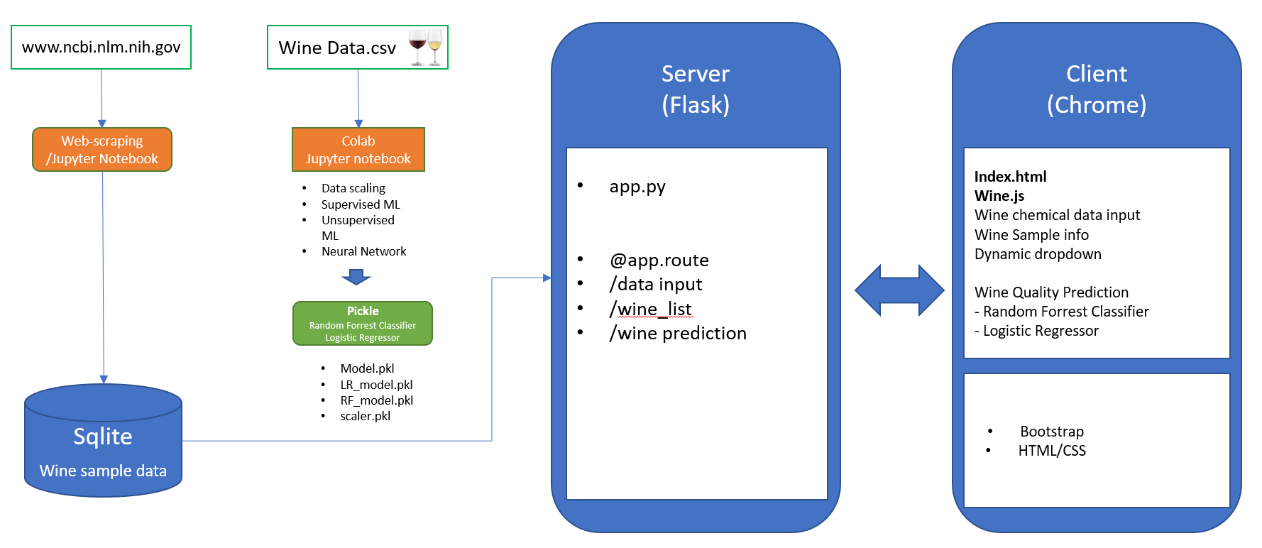
Data Architecture
Notes:
Jong -

Slide 11
Site/Tool Demonstration - Walkthrough
Notes:
Jong

Slide 12
Findings and Opportunities
Findings
Higher the alcohol, higher the quality
44% correlation between high alcohol and high quality
Lower the density and volatile acidity, higher the quality
31% and 27% correlation to high quality
Opportunities
Find better model to beat RF’s testing score of .68
Quality is subjective - hard to determine how that plays into our modeling
Notes:
Junki -
Time to wine down

Slide 13
Resources
https://online.stat.psu.edu/stat508/lesson/analysis-wine-quality-data
https://medium.com/@jamal.henani/red-wine-quality-947e3e3c275b
https://towardsdatascience.com/a-data-scientists-guide-to-buying-wine-b584c77b9e60
https://ai.plainenglish.io/prediction-of-a-wine-brands-quality-based-on-the-chemical-composition-of-the-products-using-c5727f8d4289
www.ncbi.nlm.nih.gov

Slide 14

Questions?

